Slide 1
Oil Skimmers
CGPRT(W) : Ensuring Clean Seas and Coasts in Western Region ……

Slide 2
AIM
Knowledge of common types of skimmers
Knowledge of common types of pumps and transfer systems
CGPRT(W) : Ensuring Clean Seas and Coasts in Western Region ……

Slide 3
Skimmers
CGPRT(W) : Ensuring Clean Seas and Coasts in Western Region ……

Slide 4
Skimmer
A skimmer is a mechanical device specifically designed for the removal of oil from the surface of water without altering its physical and/or chemical characteristics.
CGPRT(W) : Ensuring Clean Seas and Coasts in Western Region ……

Slide 5
Skimmer Types
Weir skimmers
Oleophilic skimmers
Vacuum skimmers
Mechanical skimmers
CGPRT(W) : Ensuring Clean Seas and Coasts in Western Region ……

Slide 6
Skimmer Selection Matrix
Refer to ExxonMobil
Oil Spill Response Field Guide
Chapter 9
CGPRT(W) : Ensuring Clean Seas and Coasts in Western Region ……

Slide 7
Weir Skimmer
Disadvantages :
Difficult adjustment of weir opening
Low efficiency in waves
Low recovery in thin slicks (10%)
Not good with very high viscosity oil
Sensitive to debris
Advantages :
High recovery rate
Wide viscosity range
Simple maintenance
Removable pump
CGPRT(W) : Ensuring Clean Seas and Coasts in Western Region ……

Slide 8
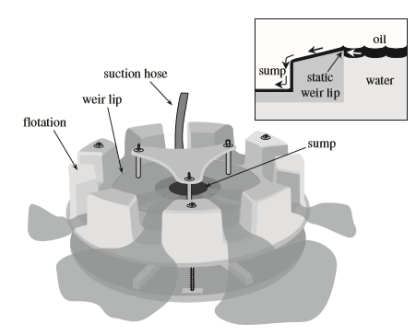
Weir Skimmer
Simple weir skimmer
Source: ExxonMobil
CGPRT(W) : Ensuring Clean Seas and Coasts in Western Region ……

Slide 9
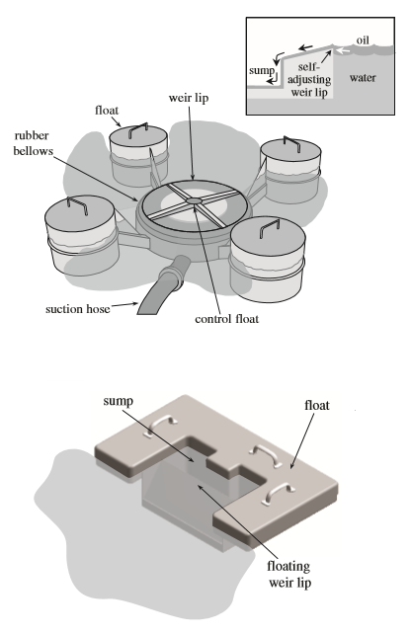
Weir Skimmer
Self-levelling weir
CGPRT(W) : Ensuring Clean Seas and Coasts in Western Region ……

Slide 10
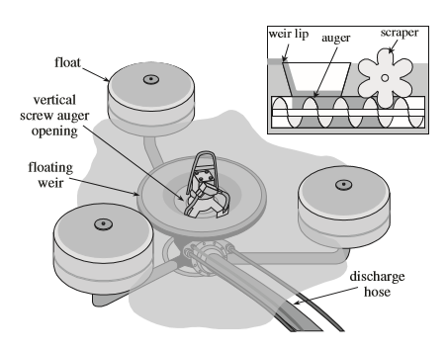
Weir Skimmer
Weir with integral screw auger
Source: ExxonMobil
CGPRT(W) : Ensuring Clean Seas and Coasts in Western Region ……

Slide 11
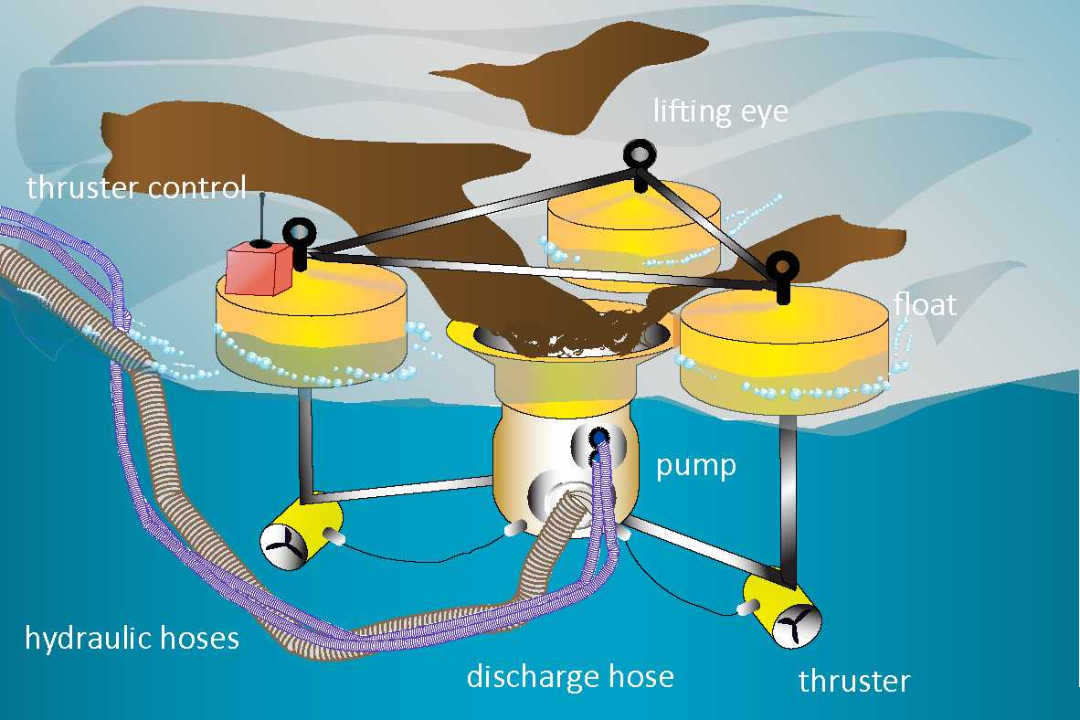
Weir Skimmer
Source: ITOPF
CGPRT(W) : Ensuring Clean Seas and Coasts in Western Region ……

Slide 12
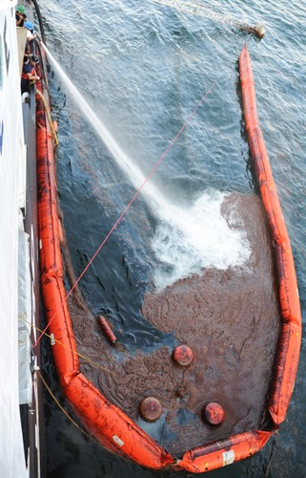
Skimming Operation
CGPRT(W) : Ensuring Clean Seas and Coasts in Western Region ……

Slide 13
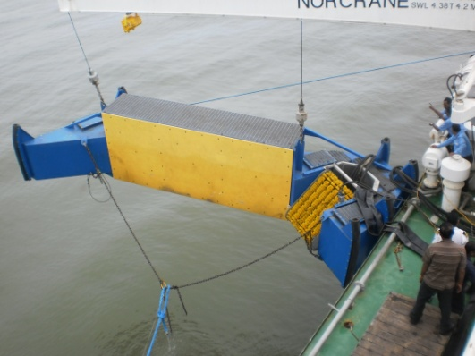
Sweep Arms
CGPRT(W) : Ensuring Clean Seas and Coasts in Western Region ……

Slide 14
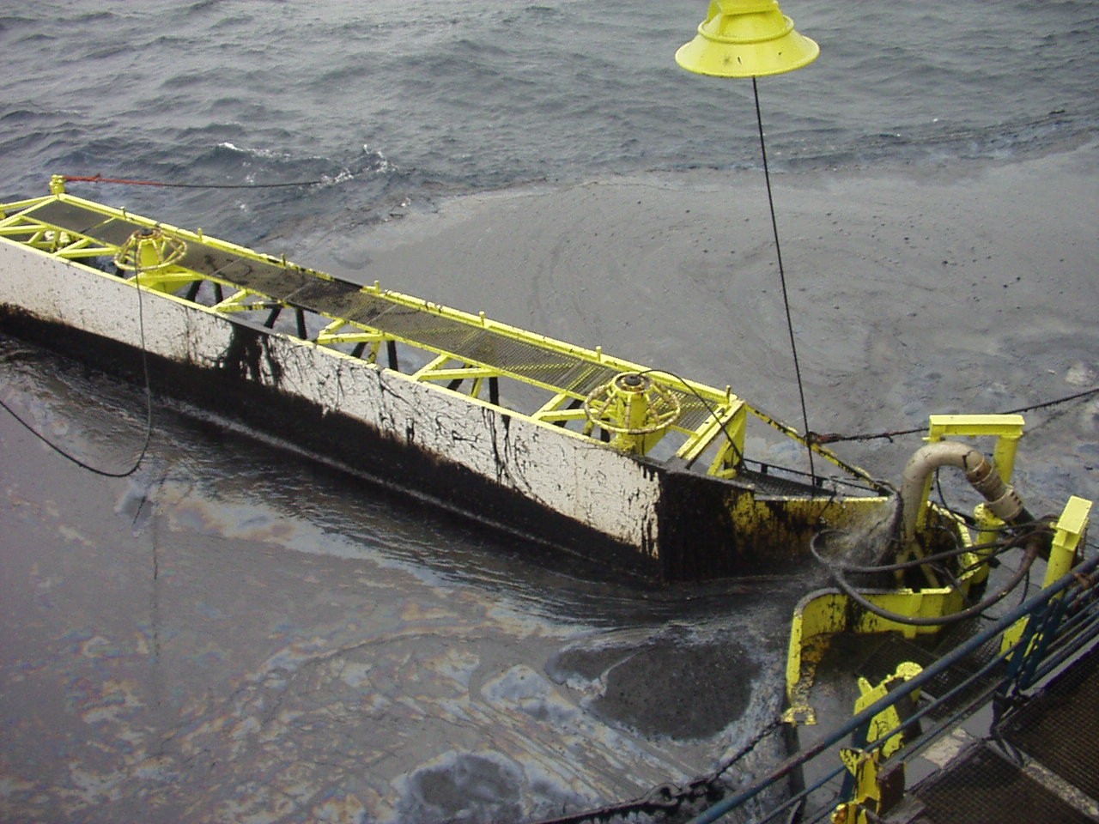
Sweep Arms
CGPRT(W) : Ensuring Clean Seas and Coasts in Western Region ……

Slide 15
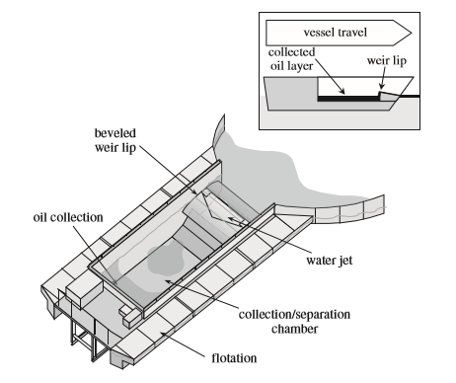
Weir Skimmer
Advancing weir skimmer
Source: ExxonMobil
CGPRT(W) : Ensuring Clean Seas and Coasts in Western Region ……

Slide 16
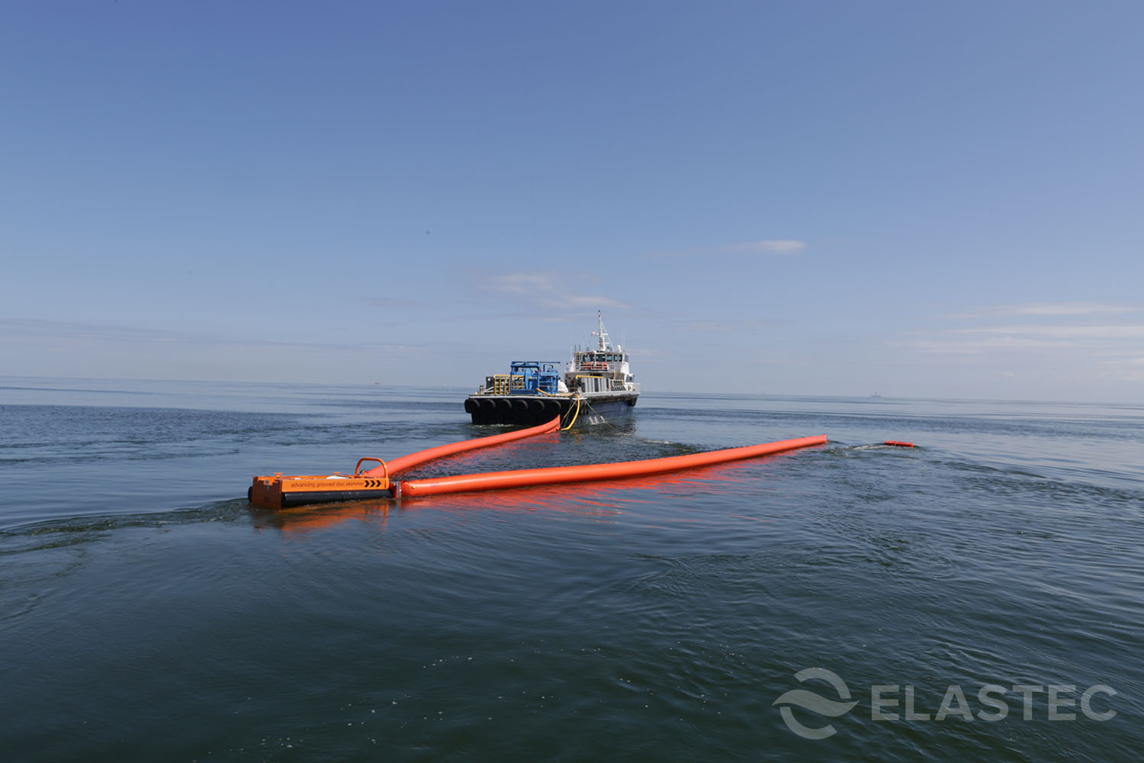
Weir Skimmer
Source: ELASTEC
CGPRT(W) : Ensuring Clean Seas and Coasts in Western Region ……

Slide 17
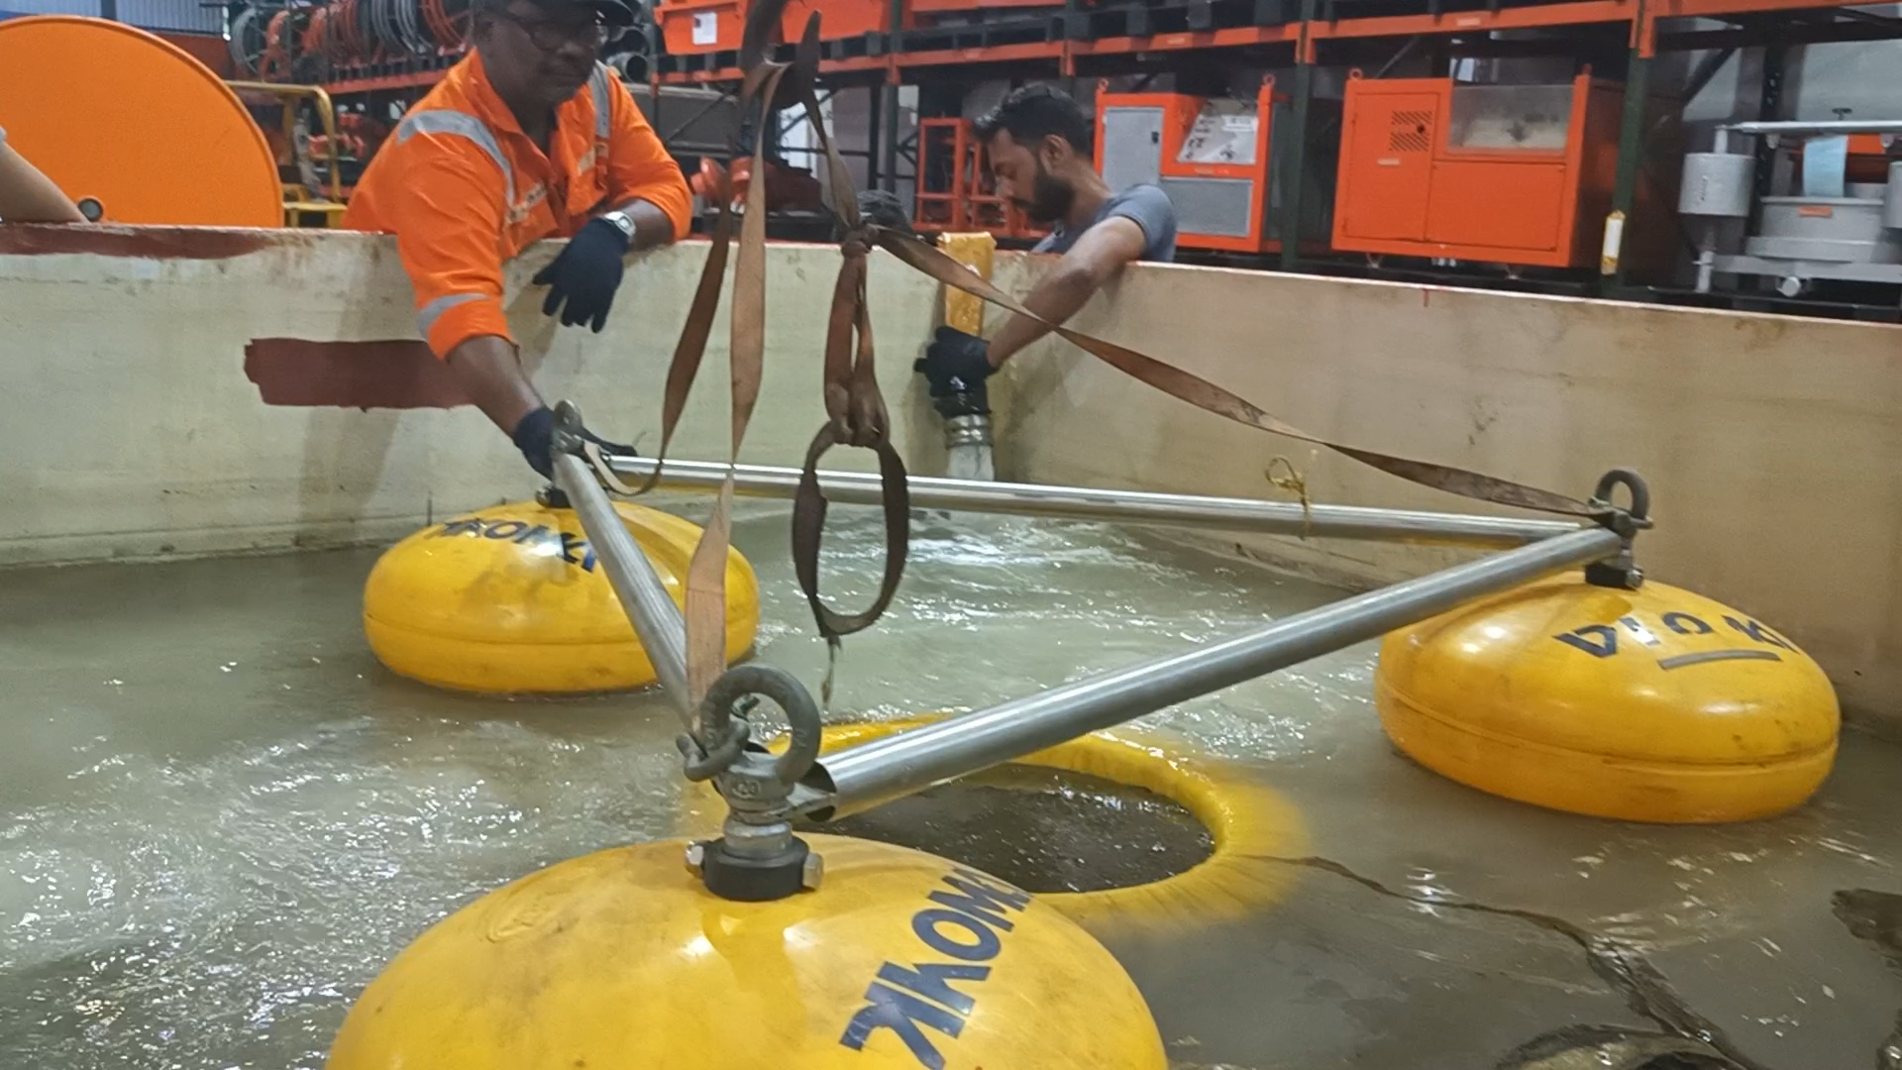
Weir Skimmer
CGPRT(W) : Ensuring Clean Seas and Coasts in Western Region ……

Slide 18
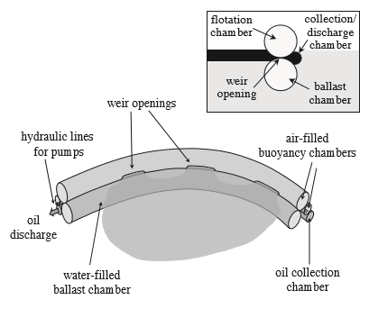
Weir Boom
Weir boom skimmer
Source: ExxonMobil
CGPRT(W) : Ensuring Clean Seas and Coasts in Western Region ……

Slide 19
Oleophilic Skimmers
Disc skimmers
Rope mop skimmers
Belt skimmers
Brush skimmers
CGPRT(W) : Ensuring Clean Seas and Coasts in Western Region ……

Slide 20
Disc Skimmer
Advantages :
Good performance with light oil
High recovery efficiency
Not sensitive to debris
Simple maintenance
Disadvantages :
Low recovery rate
Limited viscosity range
Sensitive to sea grass
Source: ITOPF
CGPRT(W) : Ensuring Clean Seas and Coasts in Western Region ……

Slide 21
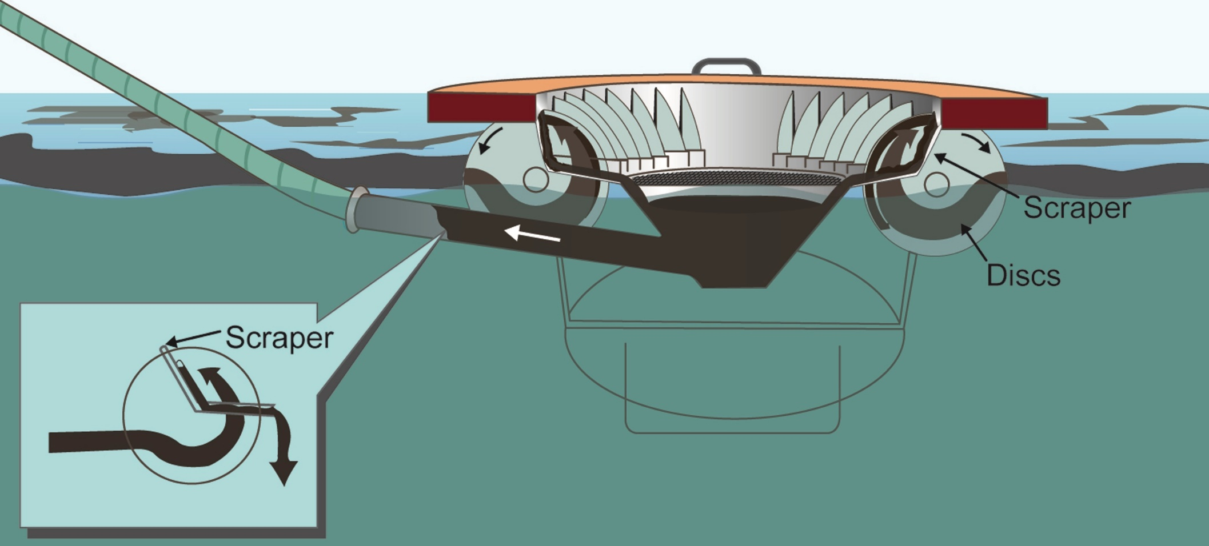
Disc Skimmer
Source: ITOPF
CGPRT(W) : Ensuring Clean Seas and Coasts in Western Region ……

Slide 22
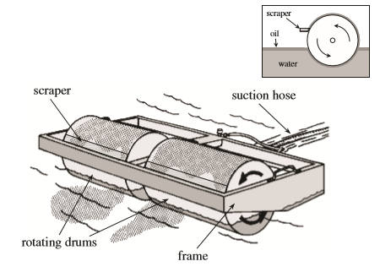
Drum skimmer
Drum skimmer
Source: ExxonMobil
CGPRT(W) : Ensuring Clean Seas and Coasts in Western Region ……

Slide 23
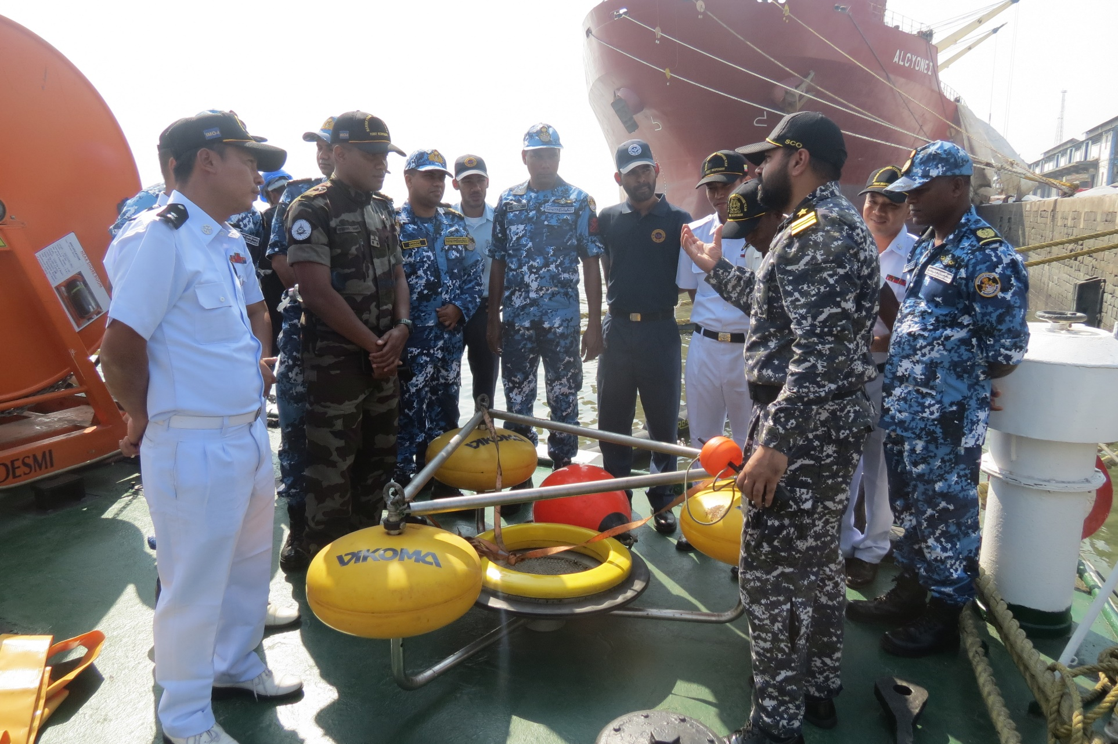
Skimmers
CGPRT(W) : Ensuring Clean Seas and Coasts in Western Region ……

Slide 24
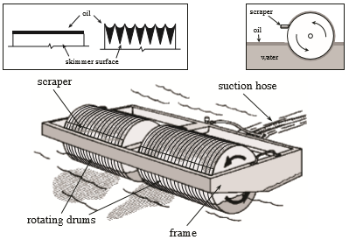
Drum Skimmer
Grooved drum skimmer
Source: ExxonMobil
CGPRT(W) : Ensuring Clean Seas and Coasts in Western Region ……

Slide 25
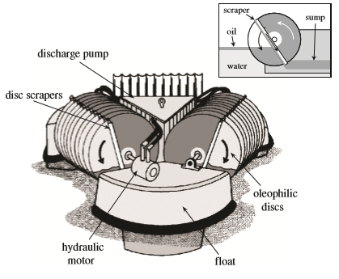
Disc Skimmer
Disc skimmer
Source: ExxonMobil
CGPRT(W) : Ensuring Clean Seas and Coasts in Western Region ……

Slide 26
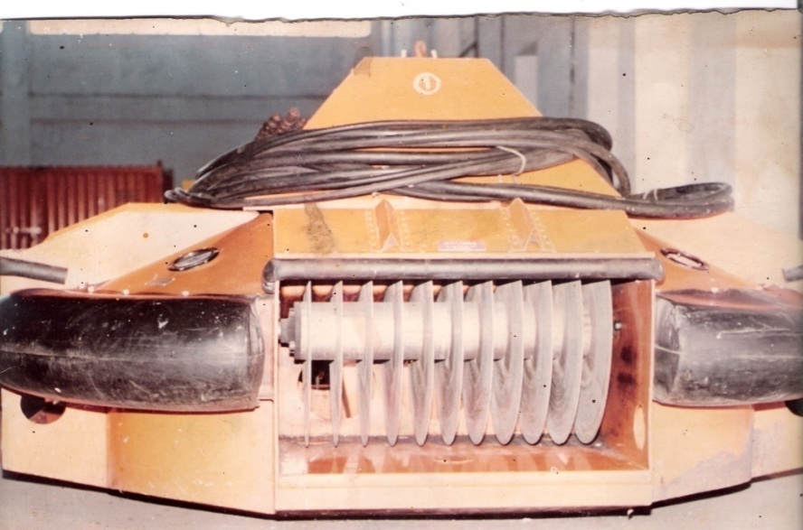
Disc Skimmer
CGPRT(W) : Ensuring Clean Seas and Coasts in Western Region ……

Slide 27
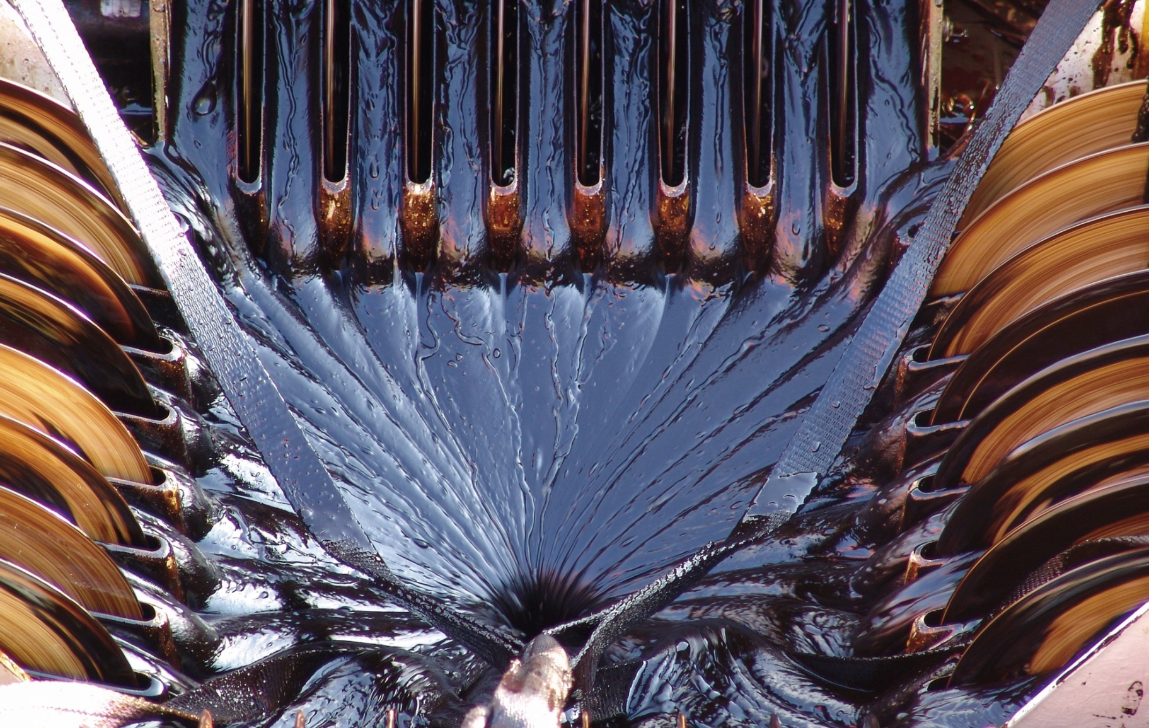
Disc Skimmer
Source: Korea Coast Guard
CGPRT(W) : Ensuring Clean Seas and Coasts in Western Region ……

Slide 28
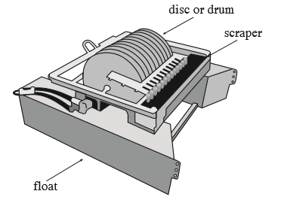
Disc Skimmer
Fabric-coated disc skimmer
Source: ExxonMobil
CGPRT(W) : Ensuring Clean Seas and Coasts in Western Region ……

Slide 29
Rope Mop Skimmers
Advantages :
Low water content in recovered oil (10%)
Good performance in debris
Flexible ropes cover large area
Easy maintenance
Disadvantages :
Low recovery rate
Limited viscosity range
Difficult to deploy correctly
CGPRT(W) : Ensuring Clean Seas and Coasts in Western Region ……

Slide 30
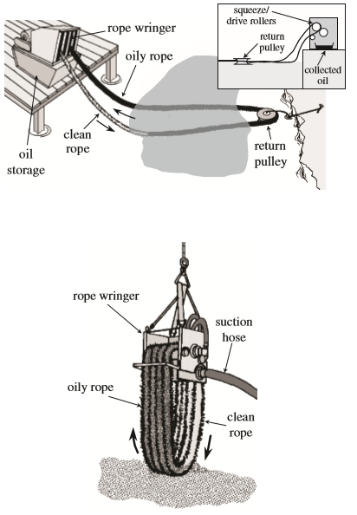
Rope Skimmer
Horizontal and vertical rope mop skimmer
Source: ExxonMobil
Source: ExxonMobil
CGPRT(W) : Ensuring Clean Seas and Coasts in Western Region ……

Slide 31
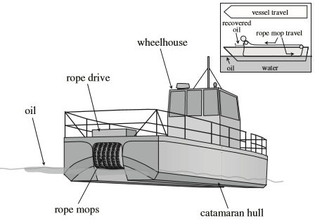
Rope Skimmer
ZRV rope mop skimmer
Source: ExxonMobil
CGPRT(W) : Ensuring Clean Seas and Coasts in Western Region ……

Slide 32
Belt Skimmer
Advantages :
High recovery rate
High recovery efficiency
Effective over wide viscosity range
Effective in high waves
Disadvantages :
Often very large
Require large vessel and heavy cranes for operation
CGPRT(W) : Ensuring Clean Seas and Coasts in Western Region ……

Slide 33
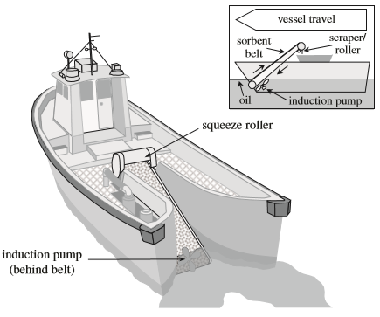
Belt Skimmer
Sorbent lifting belt
Source: ExxonMobil
CGPRT(W) : Ensuring Clean Seas and Coasts in Western Region ……

Slide 34
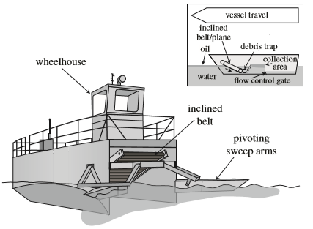
Belt Skimmer
Submersion plane/belt skimmer
Source: ExxonMobil
CGPRT(W) : Ensuring Clean Seas and Coasts in Western Region ……

Slide 35
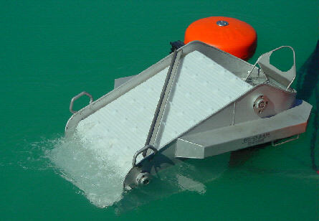
Belt Skimmer
Source: DESMI
CGPRT(W) : Ensuring Clean Seas and Coasts in Western Region ……

Slide 36
Brush Skimmer
Advantages :
High recovery efficiency
High recovery rate
Good performance in waves < 1 m
Easy maintenance
Disadvantages :
Large volume
Limited viscosity range
CGPRT(W) : Ensuring Clean Seas and Coasts in Western Region ……

Slide 37
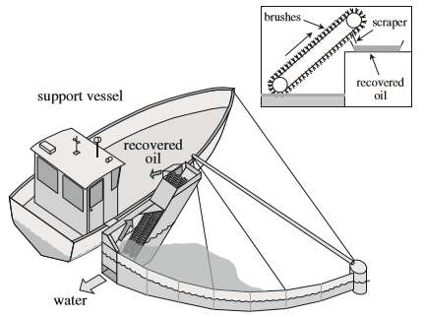
Brush Skimmer
Brush skimmer
Source: ExxonMobil
CGPRT(W) : Ensuring Clean Seas and Coasts in Western Region ……

Slide 38
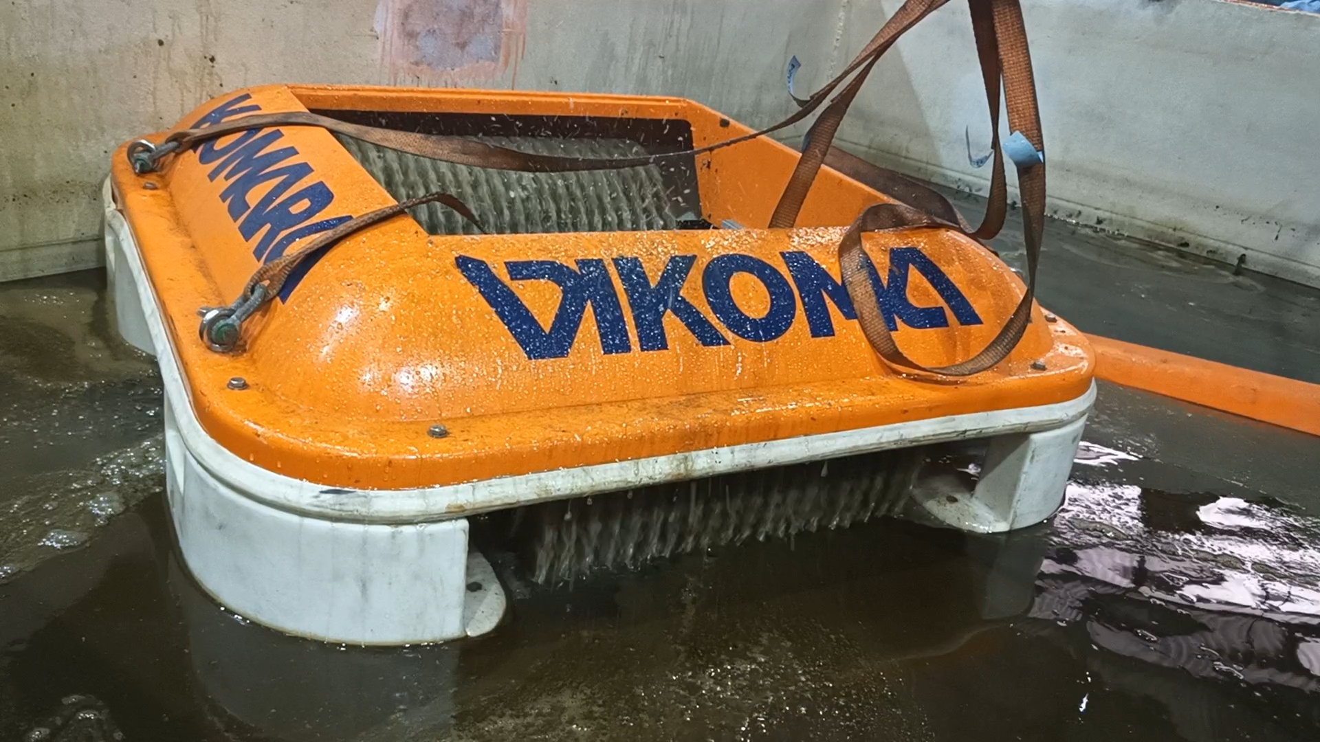
Brush Skimmer
CGPRT(W) : Ensuring Clean Seas and Coasts in Western Region ……

Slide 39
Vacuum Skimmers
Advantages :
Lightweight and portable
Can handle more viscous oils
Disadvantages :
Limited suction length
Temporary storage needs to be close to suction head
CGPRT(W) : Ensuring Clean Seas and Coasts in Western Region ……

Slide 40
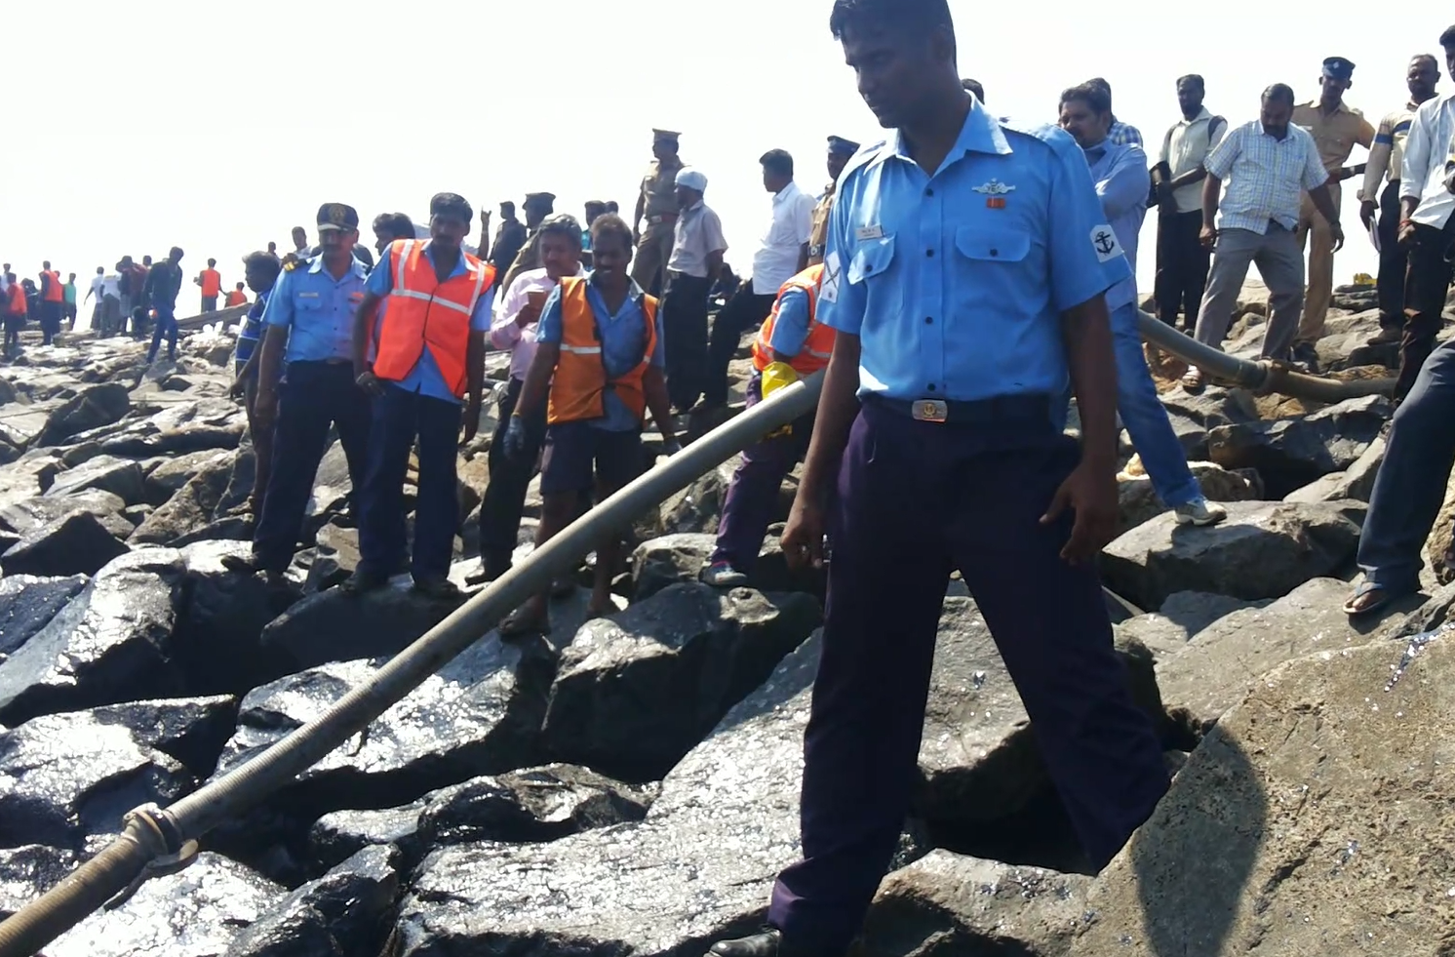
Vacuum Skimmers
CGPRT(W) : Ensuring Clean Seas and Coasts in Western Region ……

Slide 41
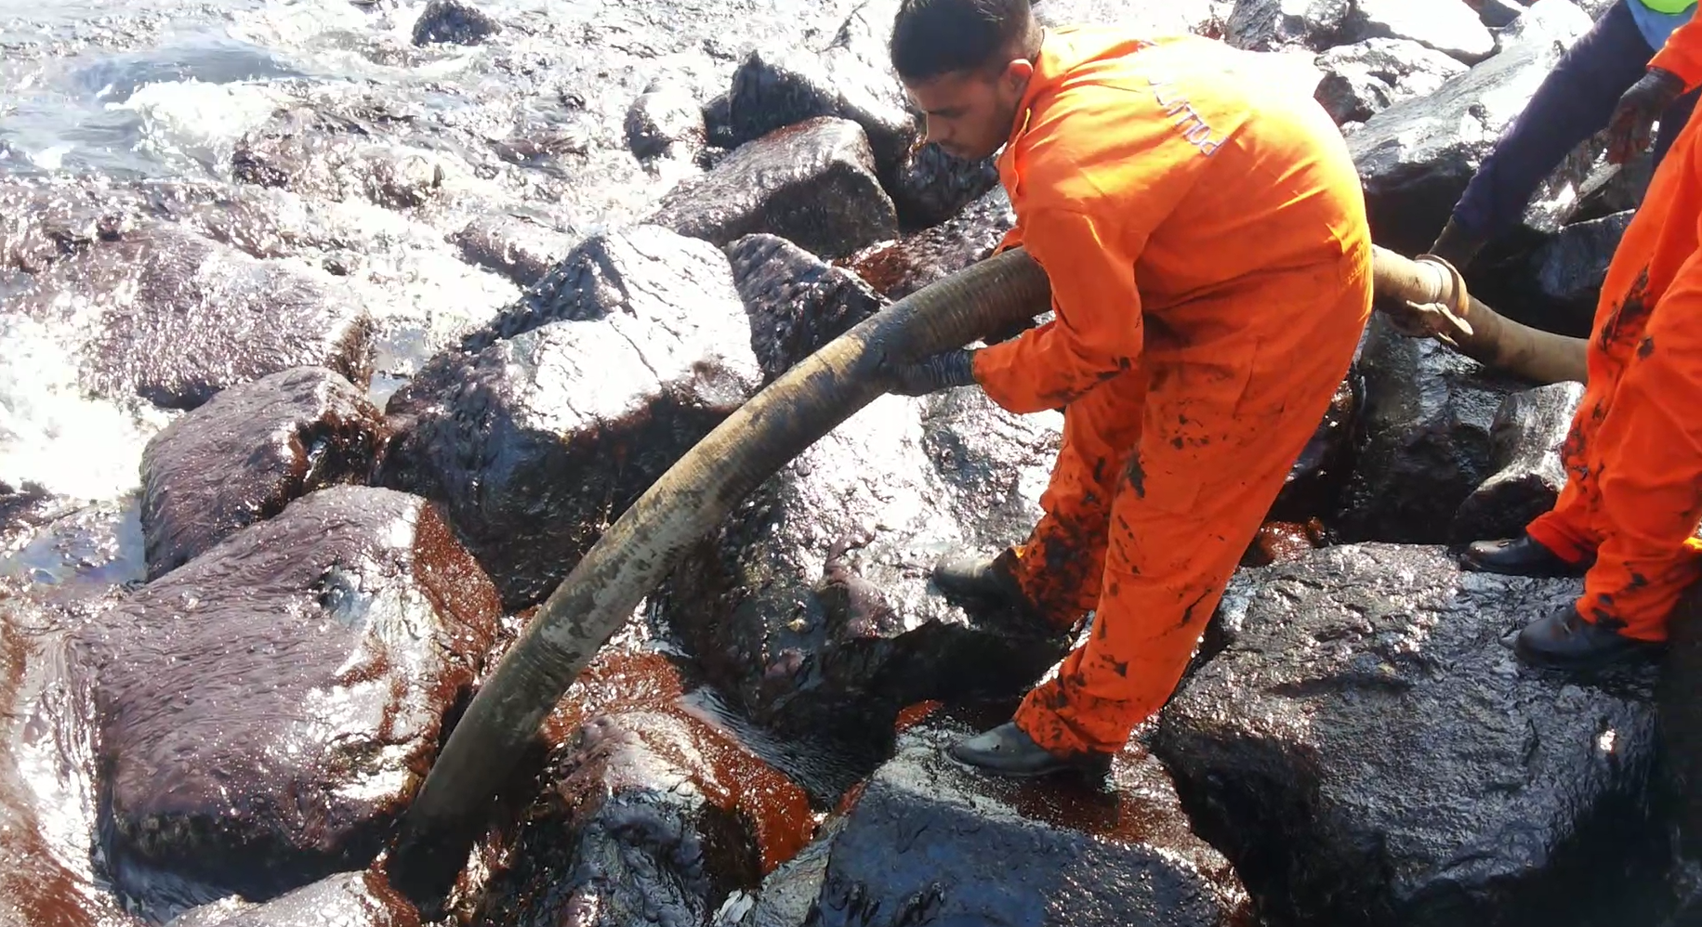
Vacuum Skimmers
CGPRT(W) : Ensuring Clean Seas and Coasts in Western Region ……

Slide 42
Mechanical Skimmers
Advantages :
Can handle very heavy and emulsified oil
Disadvantages :
Often difficult to manoeuvre units
Works only in very heavy oil
CGPRT(W) : Ensuring Clean Seas and Coasts in Western Region ……

Slide 43
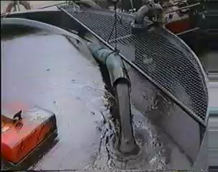
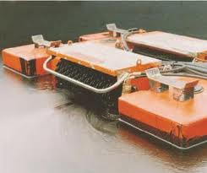
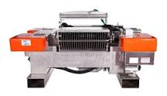
Mechanical Skimmers
Source: VIKOMA
CGPRT(W) : Ensuring Clean Seas and Coasts in Western Region ……

Slide 44
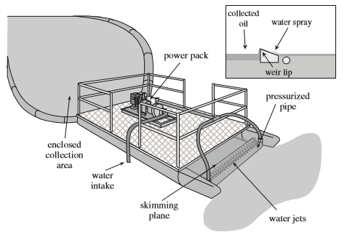
Water Jet Skimmer
Water jet skimmer
Source: ExxonMobil
CGPRT(W) : Ensuring Clean Seas and Coasts in Western Region ……

Slide 45
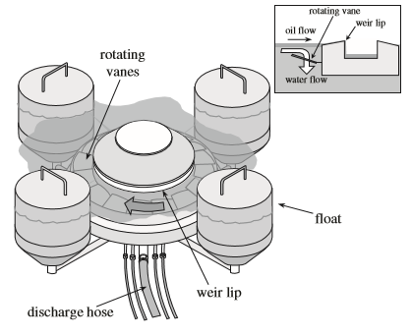
Rotating Vane Skimmer
Rotating vane skimmer
Source: ExxonMobil
CGPRT(W) : Ensuring Clean Seas and Coasts in Western Region ……

Slide 46
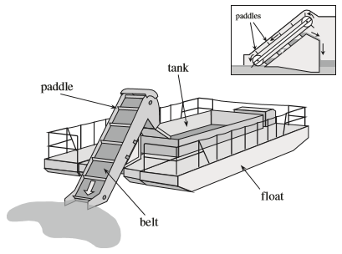
Paddle Belt Skimmer
Paddle belt skimmer
Source: ExxonMobil
CGPRT(W) : Ensuring Clean Seas and Coasts in Western Region ……

Slide 47
Practical use of Skimmers
Oil must be in a state that allows for skimming to be effective.
Encounter rate is key.
Proportion of recovered oil to spilled oil is limited due to a variety of environmental and operational factors.
Recovery can become a bottleneck in the response if logistics of pumping and storage are not managed effectively.
CGPRT(W) : Ensuring Clean Seas and Coasts in Western Region ……

Slide 48
Practical use of Skimmers
Need to consider complete logistics chain from:
mobilization from storage or stockpile
transport to staging area, dock, vessel or deployment area
offloading from transport and transfer to site
operating guidelines and running procedures
fuel or power supply
maintenance regimes
decontamination prior to removal
CGPRT(W) : Ensuring Clean Seas and Coasts in Western Region ……

Slide 49
Practical use of Skimmers
Need to consider operating procedures:
deployment and recovery criteria (sea or swell limits)
Number of personnel
PPE
H&S protocols during operations
CGPRT(W) : Ensuring Clean Seas and Coasts in Western Region ……

Slide 50
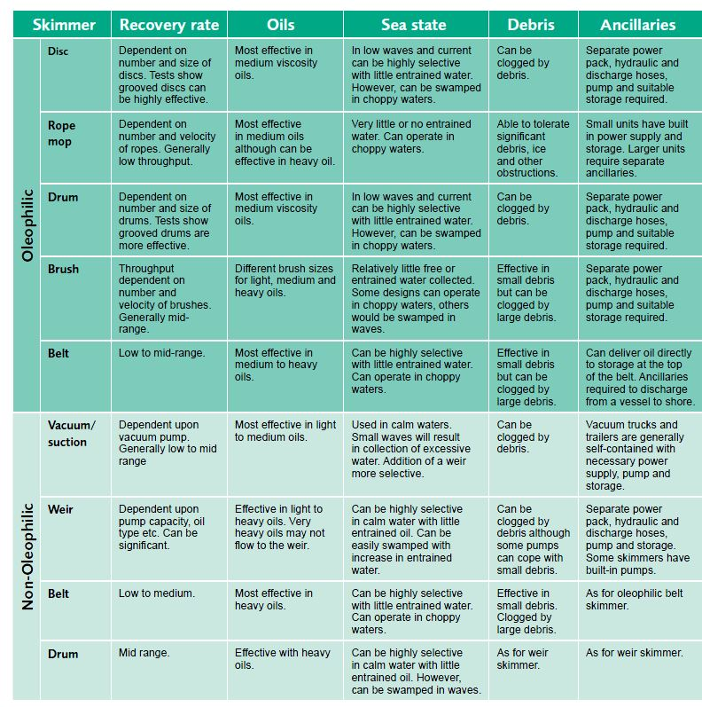
Skimmer Overview
Source: ITOPF
CGPRT(W) : Ensuring Clean Seas and Coasts in Western Region ……

Slide 51
Skimmer Overview
CGPRT(W) : Ensuring Clean Seas and Coasts in Western Region ……

Slide 52
Pumps and Transfer Systems
CGPRT(W) : Ensuring Clean Seas and Coasts in Western Region ……

Slide 53
Pumps
Key part of the recovery process.
Pumps are used to transfer recovered product from:
skimmer to interim storage
interim storage to transportation vessel/vehicle
transportation vessel/vehicle to final storage/disposal facility.
May be on board the skimmer or separate.
Pump capacity effects the overall performance of a skimming system.
CGPRT(W) : Ensuring Clean Seas and Coasts in Western Region ……

Slide 54
Pumps
Transfer systems selected to suit quantities and types of liquids being moved.
Pumps lose efficiency with increase in viscosity.
Annular water injection, shortening hoses or increasing hose diameter can help improve pump performance.
CGPRT(W) : Ensuring Clean Seas and Coasts in Western Region ……

Slide 55
Pump Selection Matrix
Refer to ExxonMobil
Oil Spill Response Field Guide
Chapter 11
Source: ExxonMobil
CGPRT(W) : Ensuring Clean Seas and Coasts in Western Region ……

Slide 56
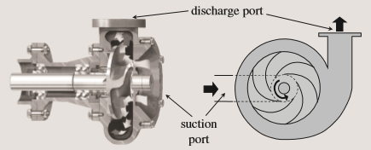
Centrifugal Pump
pumping low viscosity fluids at high rates over short distances
supplying water, flooding shoreline
CGPRT(W) : Ensuring Clean Seas and Coasts in Western Region ……

Slide 57
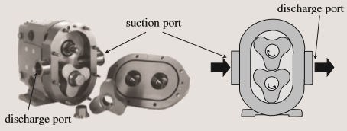
Lobe Pump
Source: ExxonMobil
pumping clean solid-free fluids
pumping heavier, viscous material
pumps against high back-pressures
CGPRT(W) : Ensuring Clean Seas and Coasts in Western Region ……

Slide 58
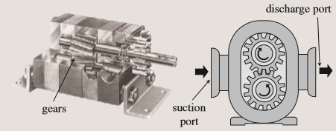
Gear Pump
Source: ExxonMobil
similar to lobe pump
pumps very viscous fluids
can run dry without serious damage
CGPRT(W) : Ensuring Clean Seas and Coasts in Western Region ……

Slide 59
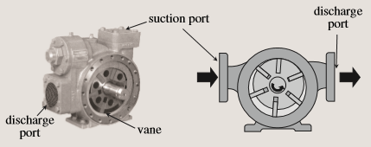
Rotary Vane Pump
small, compact and easy to handle and repair
pumps low and high viscosity fluids
CGPRT(W) : Ensuring Clean Seas and Coasts in Western Region ……

Slide 60
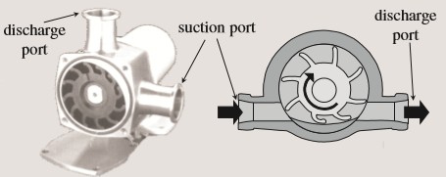
Flexible Impeller Pump
self-priming
can handle small suspended particulates
small, compact and easy to handle and repair in the field
CGPRT(W) : Ensuring Clean Seas and Coasts in Western Region ……

Slide 61
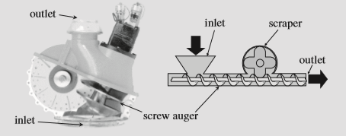
Screw/Auger Pump
can pump highly viscous or semi-solid materials
Handles most debris
CGPRT(W) : Ensuring Clean Seas and Coasts in Western Region ……

Slide 62
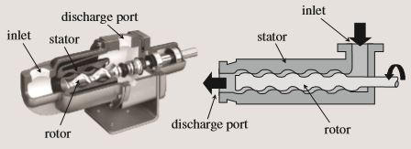
Progressive Cavity Pump
pumps various viscosities
can handle most debris
self-priming
does not emulsify oil/water
CGPRT(W) : Ensuring Clean Seas and Coasts in Western Region ……

Slide 63
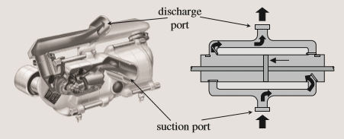
Reciprocating Pump
Can pump low to medium viscosity fluids at high pressures
strong self-priming capability and good suction lift
CGPRT(W) : Ensuring Clean Seas and Coasts in Western Region ……

Slide 64
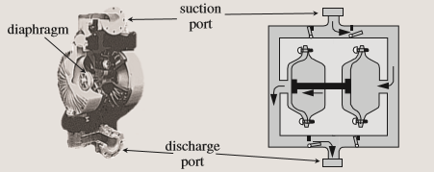
Diaphragm Pump
can run dry, self priming
good suction lift
air operated models are safe in explosive atmospheres
CGPRT(W) : Ensuring Clean Seas and Coasts in Western Region ……

Slide 65
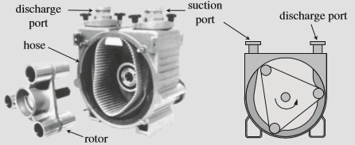
Peristaltic Pump
can run dry without damage
can pass most debris up to 25mm
self priming, good suction lift
can be reversed to clear blockages
CGPRT(W) : Ensuring Clean Seas and Coasts in Western Region ……

Slide 66
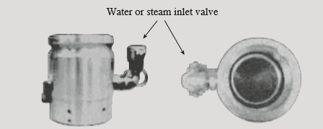
Pumping Assistance
Annular injection flange
aids pumping by reducing friction in discharge hose
CGPRT(W) : Ensuring Clean Seas and Coasts in Western Region ……

Slide 67
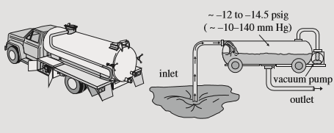
Transfer Systems
Vacuum truck
CGPRT(W) : Ensuring Clean Seas and Coasts in Western Region ……

Slide 68
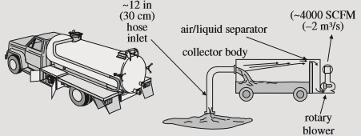
Transfer Systems
Air conveyor
Source: ExxonMobil
CGPRT(W) : Ensuring Clean Seas and Coasts in Western Region ……

Slide 69
Health and Safety
Keep hands/clothing away from moving parts.
Wear gloves.
Do not attempt to clear debris from a working skimmer.
Be aware of oil-covered surfaces.
Use caution around hydraulic hoses – safety glasses, hoses, whip checks.
Inspect equipment before and during use.
CGPRT(W) : Ensuring Clean Seas and Coasts in Western Region ……

Slide 70
Summary
It is necessary to match a skimmer selection to conditions and to have access to a range of skimmer types to suit risks and oil weathering profile.
Examples:
Weir skimmers – mostly for open sea operations.
Oleophilic – many advantages in nearshore or onshore operations.
Vacuum skimmers – uncomplicated and lightweight.
Mechanical – normally only for heavy oil and debris.
Pumps are an essential part of the recovery process.
CGPRT(W) : Ensuring Clean Seas and Coasts in Western Region ……

Slide 71
Any questions?
CGPRT(W) : Ensuring Clean Seas and Coasts in Western Region ……

